Slide 1
PROCESSING
SOURCES OF INFORMATION AND INSPIRATION

Slide 2
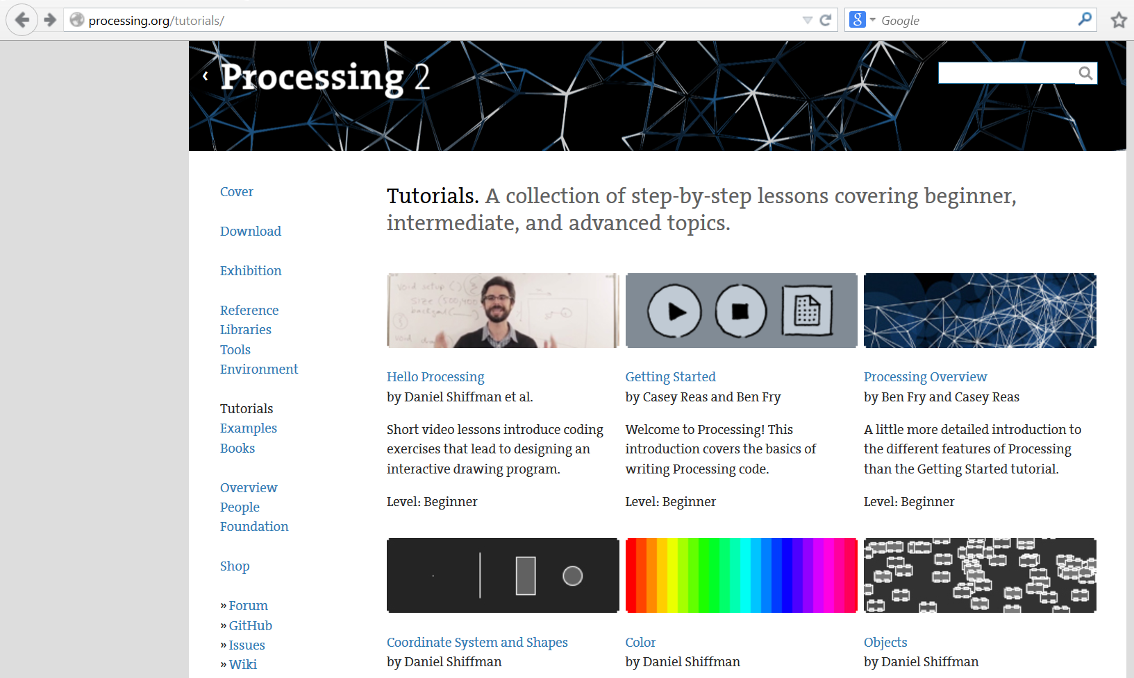
http://processing.org/tutorials
Processing tutorials

Slide 3
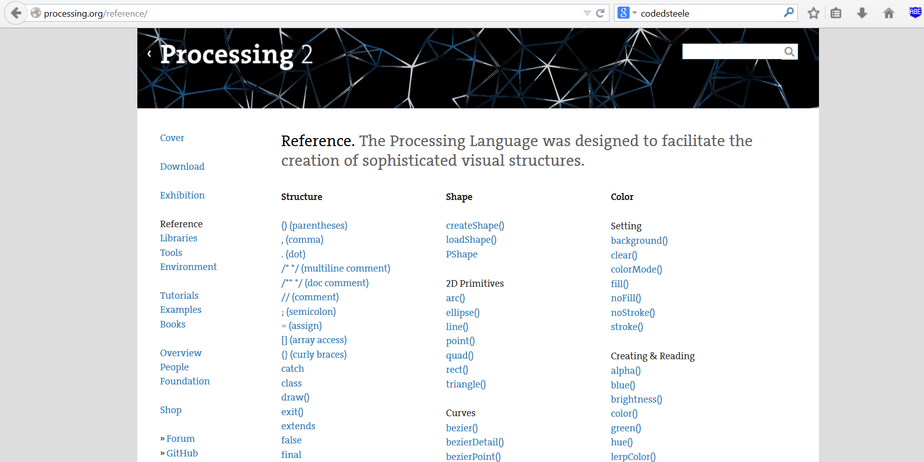
http://processing.org/reference
Processing reference – useful if you have forgotten how to use a function.

Slide 4
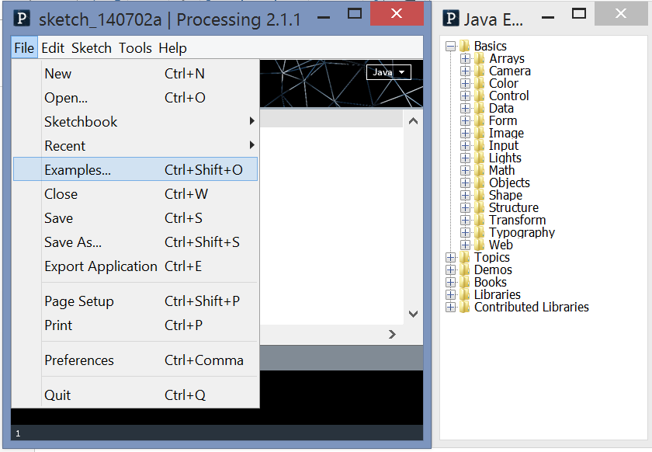
Example code within the Processing Development Environment

Slide 5
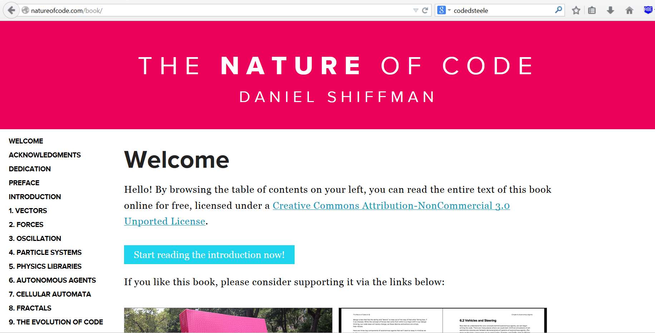
http://natureofcode.com/book
The Nature of Code – lots of interesting demos, tutorials, great for simulations of the natural world

Slide 6

http://beesandbombs.tumblr.com
Bees and Bombs – gifs by David Whyte

Slide 7

http://beesandbombs.tumblr.com
Bees and Bombs – gifs by David Whyte

Slide 8

http://beesandbombs.tumblr.com
Bees and Bombs – gifs by David Whyte

Slide 9
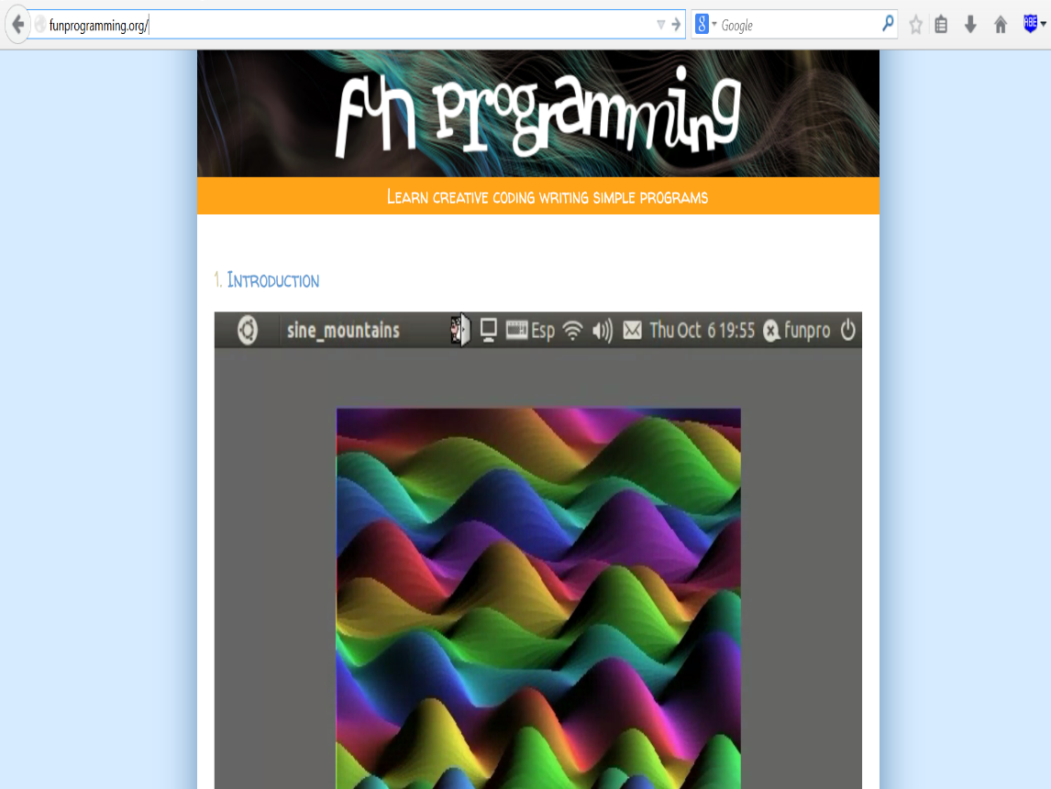
http://funprogramming.org
Fun Programming – creative programming tutorials

Slide 10
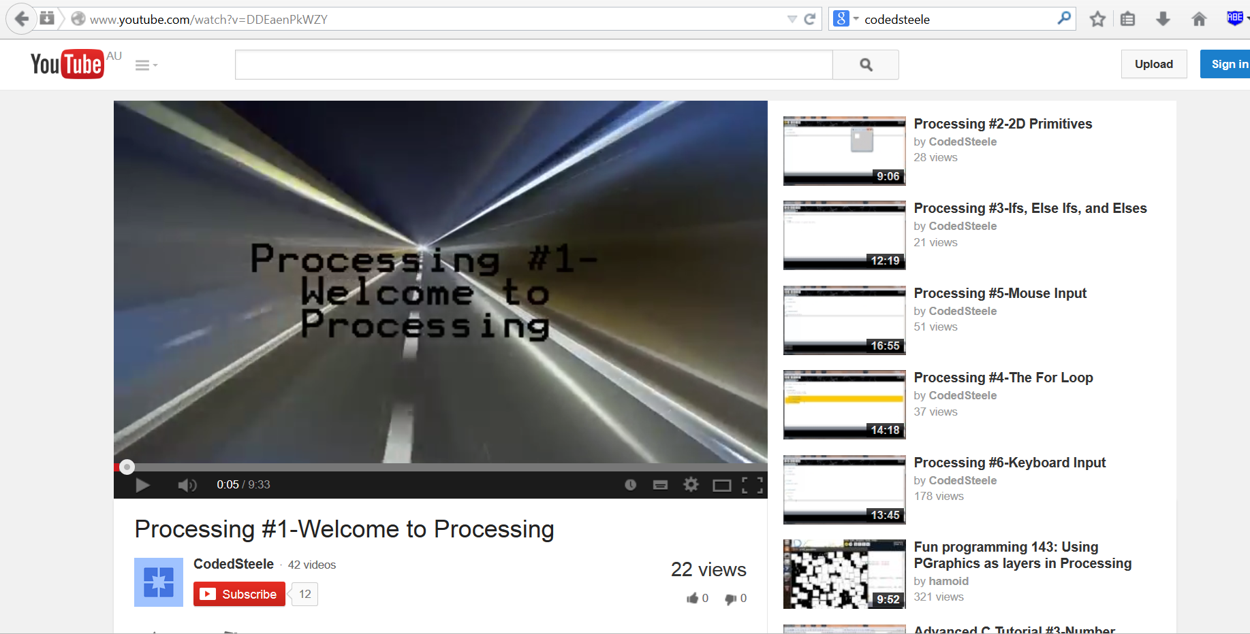
http://www.youtube.com/user/hannemannj
CodedSteele tutorials – a little long-winded but possibly useful!

Slide 11

http://github.com
Github – code sharing, collaboration, distribution, version control

Slide 12
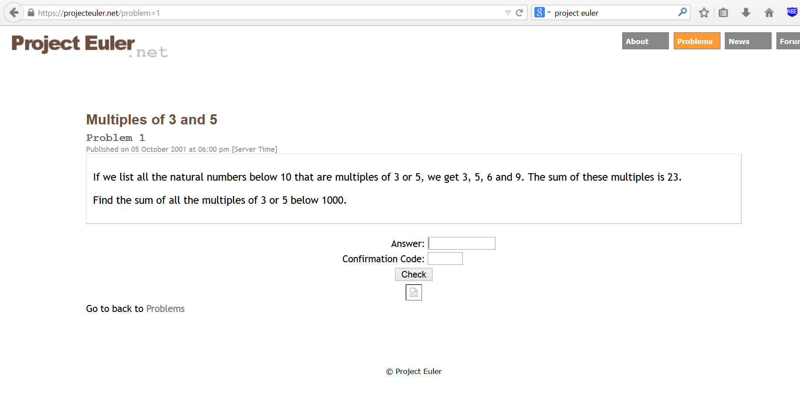
http://projecteuler.net
Project Euler – a vast series of increasingly difficult computational mathematics challenges

